Slide 1


Spark Streaming and Sliding Window Analytics
Dr. Rajiv Misra
Dept. of Computer Science & Engg.
Indian Institute of Technology Patna
rajivm@iitp.ac.in
Big Data Computing
Spark Streaming

Slide 2

Preface
Content of this Lecture:
In this lecture, we will discuss Real-time big data processing with Spark Streaming and Sliding Window Analytics.
We will also discuss a case study based on Twitter Sentiment Analysis with using Streaming.
Big Data Computing
Spark Streaming

Slide 3
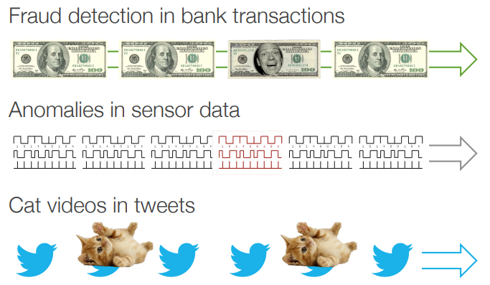
Big Streaming Data Processing
Big Data Computing
Spark Streaming

Slide 4
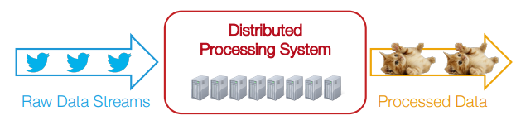
How to Process Big Streaming Data
Scales to hundreds of nodes
Achieves low latency
Efficiently recover from failures
Integrates with batch and interactive processing
Big Data Computing
Spark Streaming

Slide 5
What people have been doing?
Build two stacks – one for batch, one for streaming
Often both process same data
Existing frameworks cannot do both
Either, stream processing of 100s of MB/s with low latency
Or, batch processing of TBs of data with high latency
Big Data Computing
Spark Streaming

Slide 6
What people have been doing?
Extremely painful to maintain two different stacks
Different programming models
Doubles implementation effort
Doubles operational effort
Big Data Computing
Spark Streaming

Slide 7
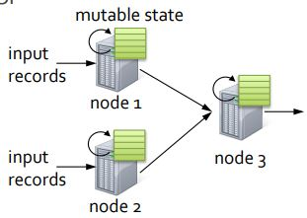
Fault-tolerant Stream Processing
Traditional processing model
Pipeline of nodes
Each node maintains mutable state
Each input record updates the state and new records are sent out
Mutable state is lost if node fails
Making stateful stream processing fault-tolerant is challenging!
Big Data Computing
Spark Streaming

Slide 8
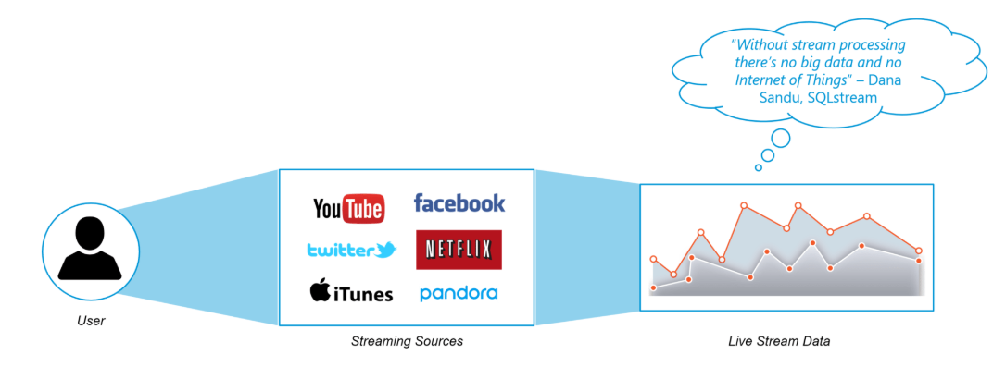
What is Streaming?
Data Streaming is a technique for transferring data so that it can be processed as a steady and continuous stream.
Streaming technologies are becoming increasingly important with the growth of the Internet.
Big Data Computing
Spark Streaming

Slide 9
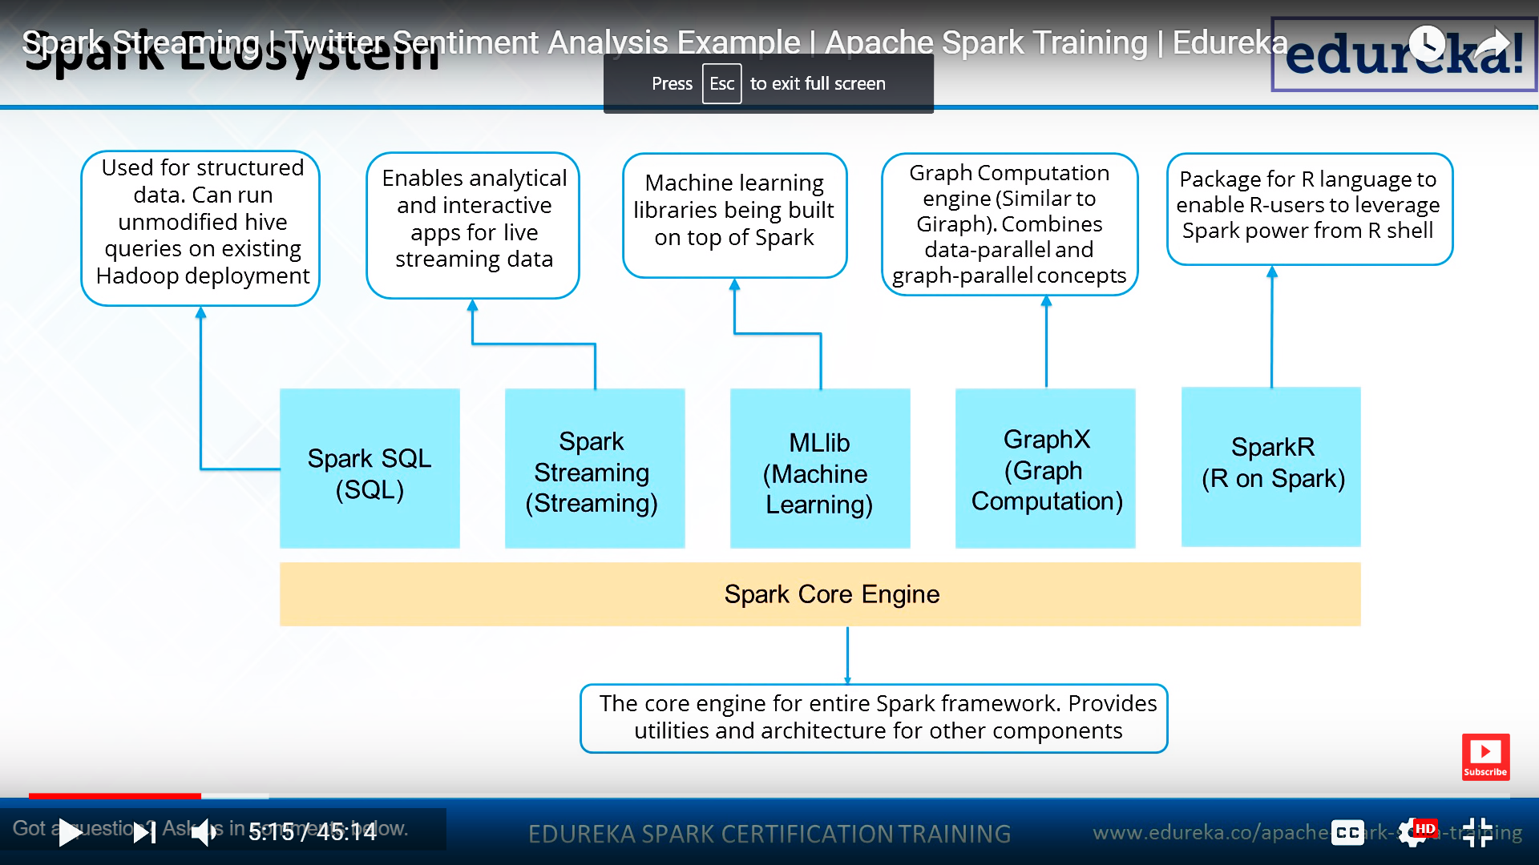
Spark Ecosystem
Big Data Computing
Spark Streaming

Slide 10
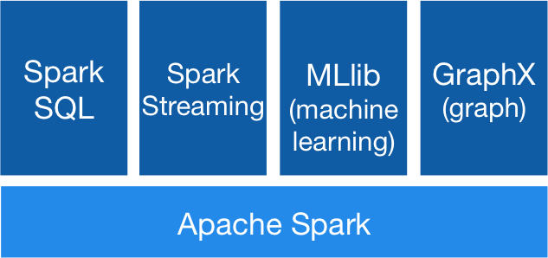
What is Spark Streaming?
Extends Spark for doing big data stream processing
Project started in early 2012, alpha released in Spring 2017 with Spark 0.7
Moving out of alpha in Spark 0.9
Spark Streaming has support built-in to consume from Kafka, Flume, Twitter, ZeroMQ, Kinesis, and TCP/IP sockets.
In Spark 2.x, a separate technology based on Datasets, called Structured Streaming, that has a higher-level interface is also provided to support streaming.
Big Data Computing
Spark Streaming

Slide 11
What is Spark Streaming?
Framework for large scale stream processing
Scales to 100s of nodes
Can achieve second scale latencies
Integrates with Spark’s batch and interactive processing
Provides a simple batch-like API for implementing complex algorithm
Can absorb live data streams from Kafka, Flume, ZeroMQ, etc.
Big Data Computing
Spark Streaming

Slide 12
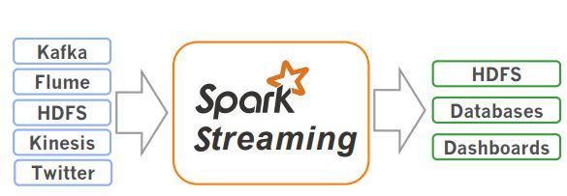
What is Spark Streaming?
Receive data streams from input sources, process them in a cluster, push out to databases/ dashboards
Scalable, fault-tolerant, second-scale latencies
Big Data Computing
Spark Streaming

Slide 13
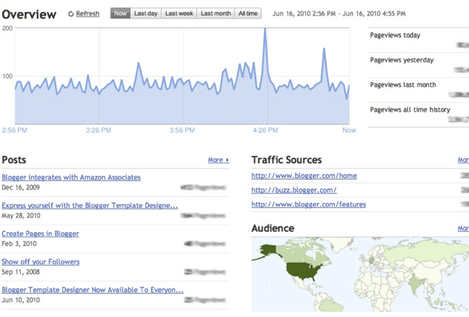

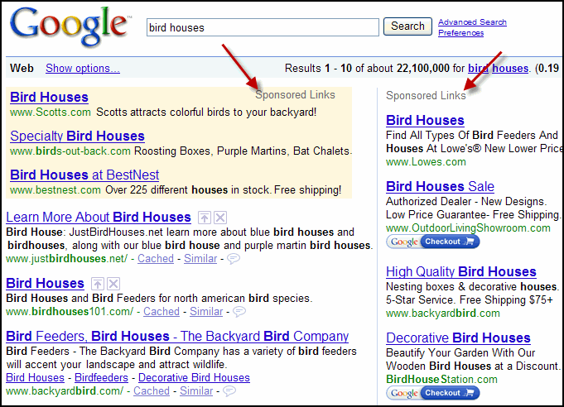
Why Spark Streaming ?
Many big-data applications need to process large data streams in realtime
Website monitoring
Fraud detection
Ad monetization
Big Data Computing
Spark Streaming

Slide 14
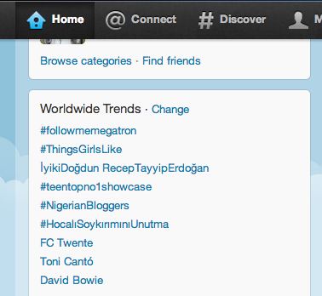
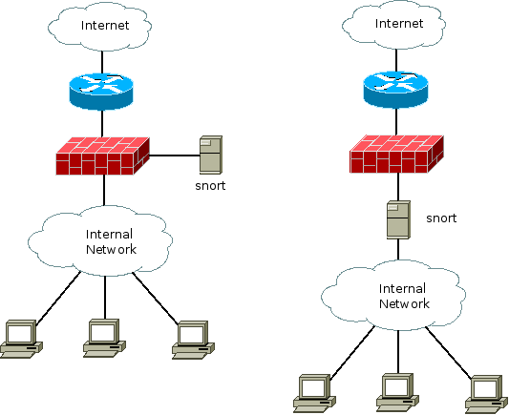
Why Spark Streaming ?
Many important applications must process large streams of live data and provide results in near-real-time
Social network trends
Website statistics
Intrustion detection systems
etc.
Require large clusters to handle workloads
Require latencies of few seconds
Big Data Computing
Spark Streaming

Slide 15
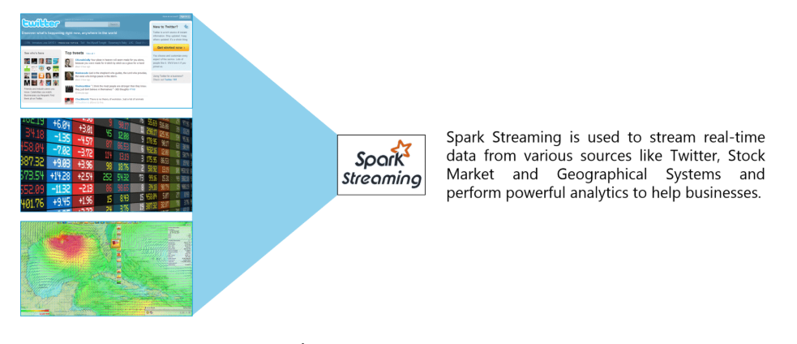
Why Spark Streaming ?
We can use Spark Streaming to stream real-time data from various sources like Twitter, Stock Market and Geographical Systems and perform powerful analytics to help businesses.
Big Data Computing
Spark Streaming

Slide 16
Why Spark Streaming?
Need a framework for big data
stream processing that
Website monitoring
Scales to hundreds of nodes
Achieves second-scale latencies
Efficiently recover from failures
Integrates with batch and interactive processing
Fraud detection
Ad monetization
Big Data Computing
Spark Streaming

Slide 17
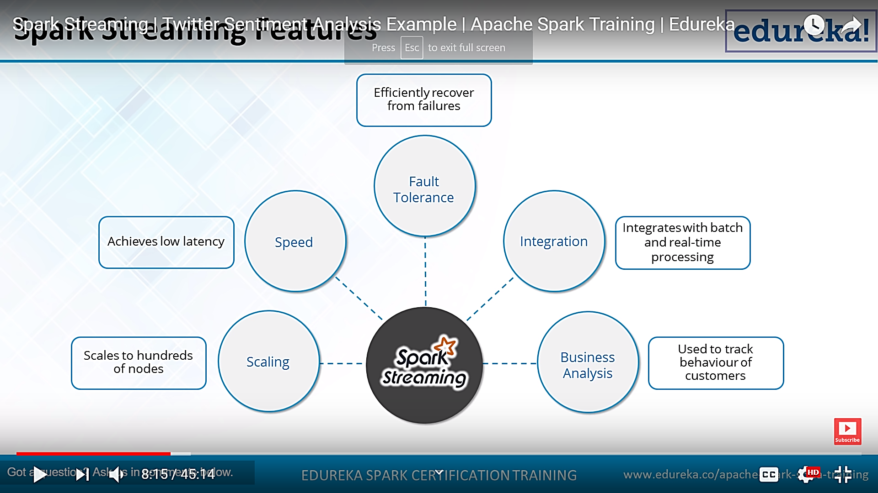
Spark Streaming Features
Scaling: Spark Streaming can easily scale to hundreds of nodes.
Speed: It achieves low latency.
Fault Tolerance: Spark has the ability to efficiently recover from failures.
Integration: Spark integrates with batch and real-time processing.
Business Analysis: Spark Streaming is used to track the behavior of customers which can be used in business analysis
Big Data Computing
Spark Streaming

Slide 18
Requirements
Scalable to large clusters
Second-scale latencies
Simple programming model
Integrated with batch & interactive processing
Efficient fault-tolerance in stateful computations
Big Data Computing
Spark Streaming

Slide 19
Batch vs Stream Processing
Batch Processing
Ability to process and analyze data at-rest (stored data)
Request-based, bulk evaluation and short-lived processing
Enabler for Retrospective, Reactive and On-demand Analytics
Stream Processing
Ability to ingest, process and analyze data in-motion in real- or near-real-time
Event or micro-batch driven, continuous evaluation and long-lived processing
Enabler for real-time Prospective, Proactive and Predictive Analytics for Next Best Action
Stream Processing + Batch Processing = All Data Analytics
real-time (now) historical (past)
Big Data Computing
Spark Streaming

Slide 20

Integration with Batch Processing
Many environments require processing same data in live streaming as well as batch post-processing
Existing frameworks cannot do both
Either, stream processing of 100s of MB/s with low latency
Or, batch processing of TBs of data with high latency
Extremely painful to maintain two different stacks
Different programming models
Double implementation effort
Big Data Computing
Spark Streaming

Slide 21

Stateful Stream Processing
Traditional model
Mutable state is lost if node fails
Making stateful stream processing fault tolerant is challenging!
mutable state
Processing pipeline of nodes
Each node maintains mutable state
Each input record updates the state and new records are sent out
input
records
node 1
input
records
node 3
node 2
Big Data Computing
Spark Streaming
Notes:
Traditional stream processing use the continuous operator model, where every node in the processing pipeline continuously run an operator with in-memory mutable state. As each input records is received, the mutable state is updated and new records are sent out to downstream nodes. The problem with this model is that the mutable state is lost if the node fails. To deal with this ,various techniques have been developed to make this state fault-tolerant. I am going to divide them into two broad classes and explain their limitations.

Slide 22
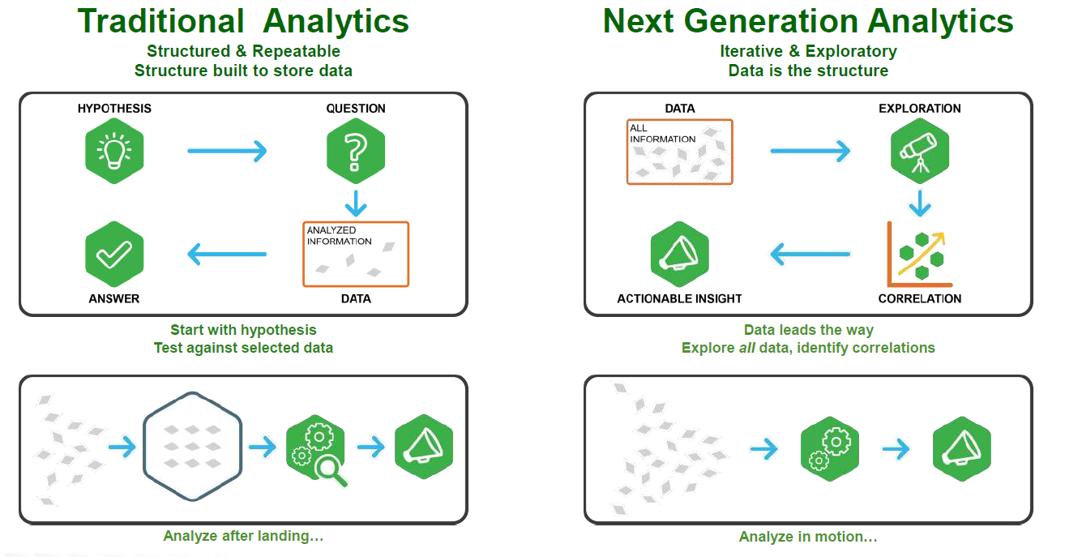
Modern Data Applications approach to Insights
Big Data Computing
Spark Streaming

Slide 23
Existing Streaming Systems
Storm
Replays record if not processed by a node
Processes each record at least once
May update mutable state twice!
Mutable state can be lost due to failure!
Trident – Use transactions to update state
Processes each record exactly once
Per-state transaction to external database is slow
Big Data Computing
Spark Streaming

Slide 24
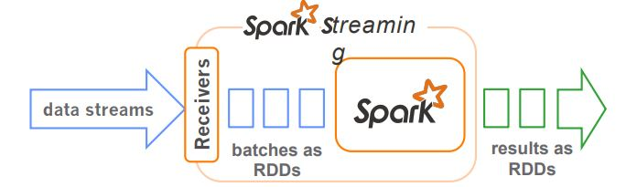
How does Spark Streaming work?
Run a streaming computation as a series of very small, deterministic batch jobs
live data stream
Spark
Streaming
Chop up the live stream into batches of X seconds
Spark treats each batch of data as RDDs and processes them using RDD operations
Finally, the processed results of the RDD operations are returned in batches
batches of X seconds
Spark
processed results
Big Data Computing
Spark Streaming

Slide 25
How does Spark Streaming work?
Run a streaming computation as a series of very small, deterministic batch jobs
live data stream
Spark
Streaming
Batch sizes as low as ½ second, latency of about 1 second
Potential for combining batch processing and streaming processing in the same system
batches of X seconds
Spark
processed results
Big Data Computing
Spark Streaming

Slide 26
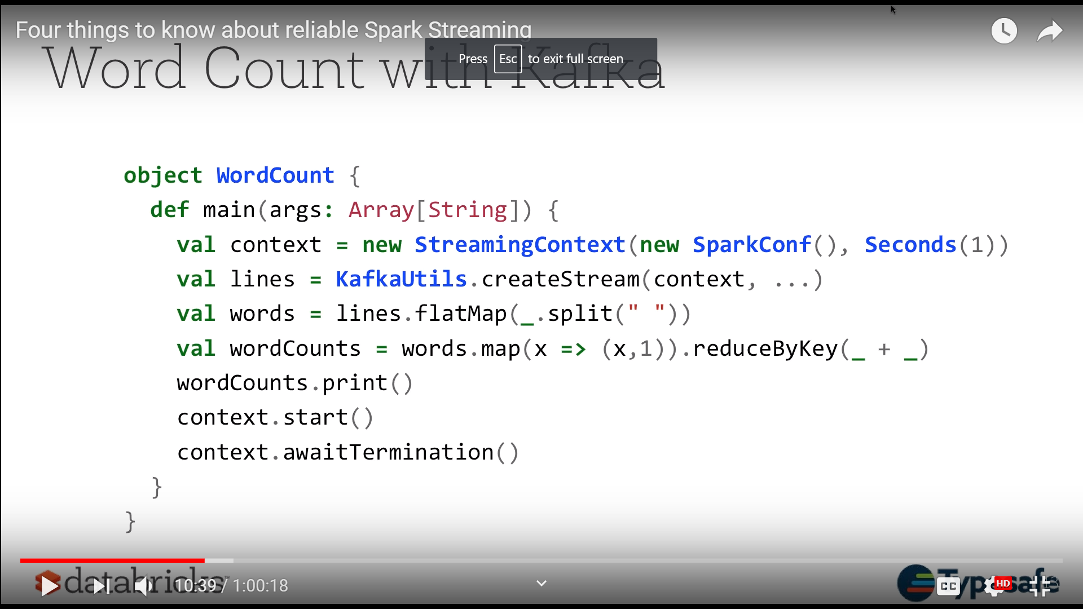
Word Count with Kafka
Big Data Computing
Spark Streaming

Slide 27
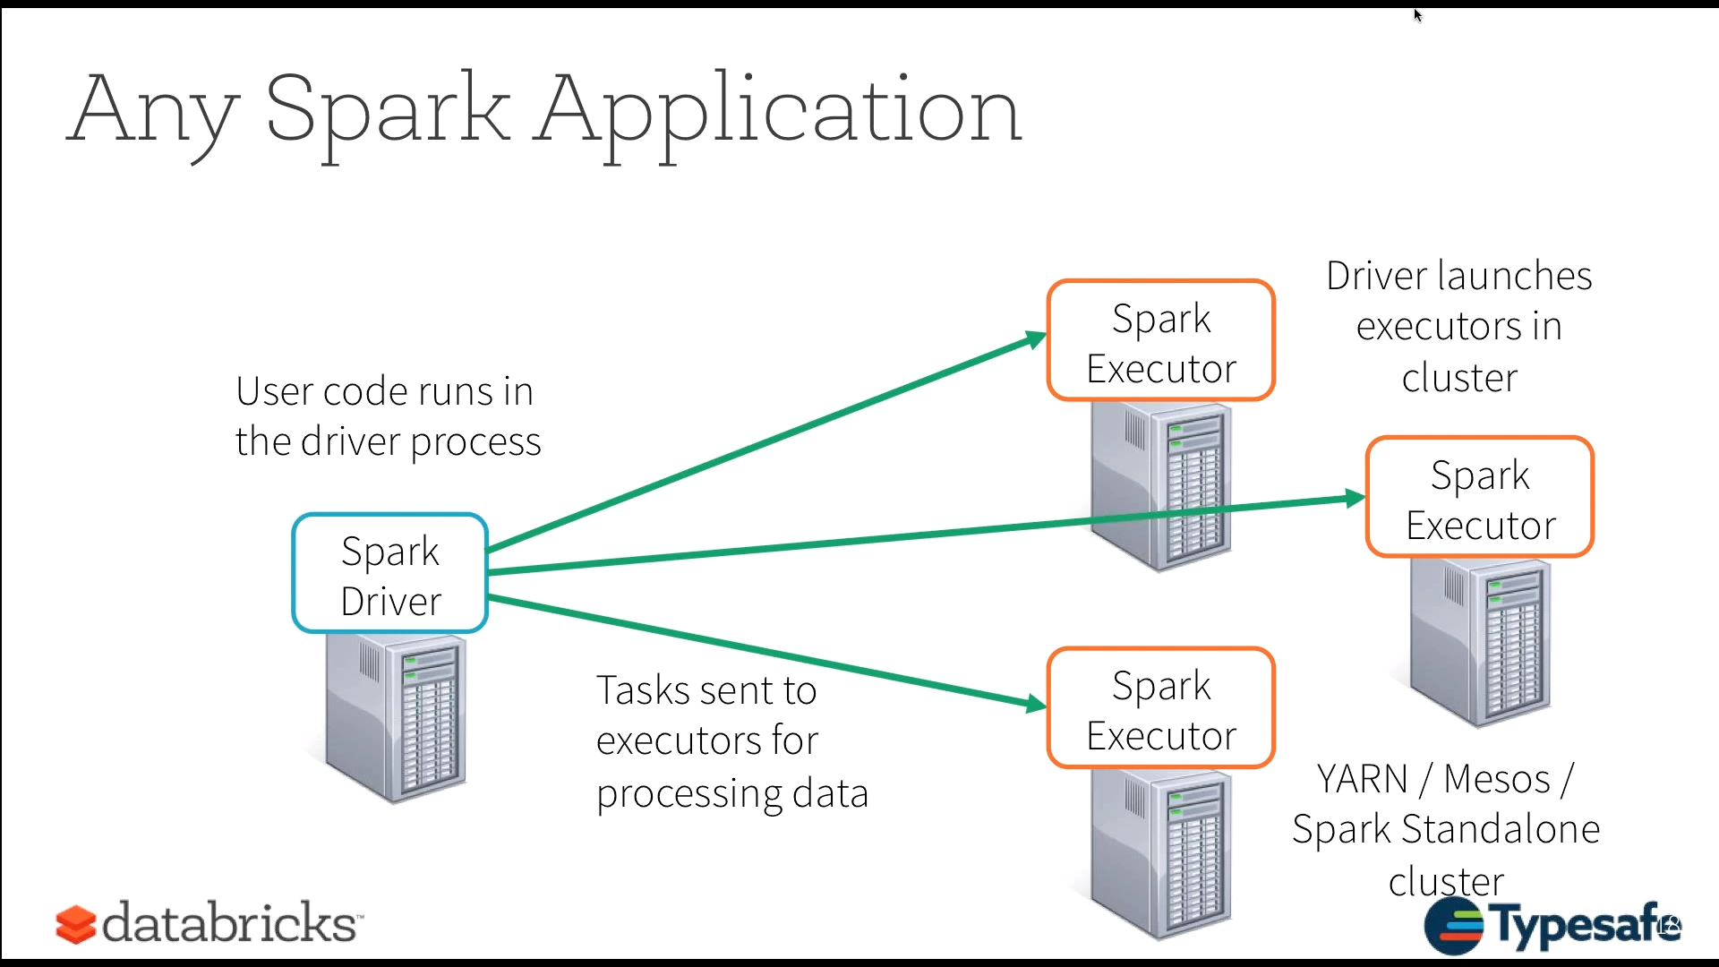
Any Spark Application
Big Data Computing
Spark Streaming

Slide 28
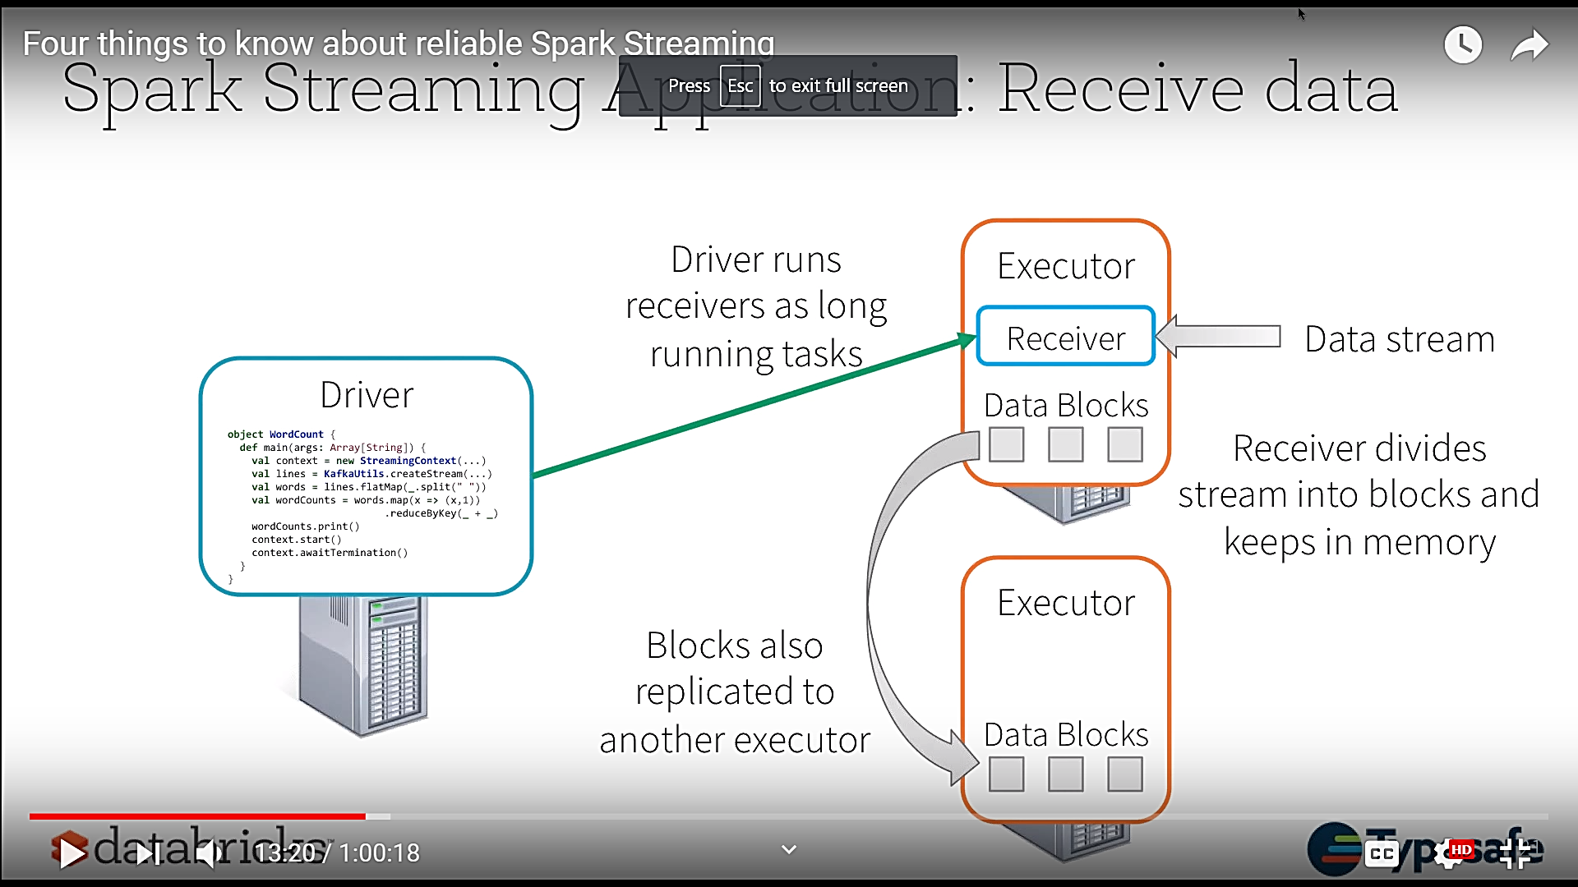
Spark Streaming Application: Receive data
Big Data Computing
Spark Streaming

Slide 29
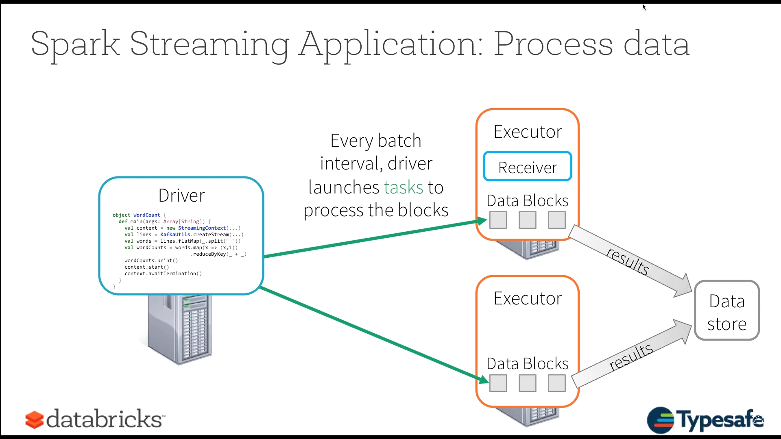
Spark Streaming Application: Process data
Big Data Computing
Spark Streaming

Slide 30
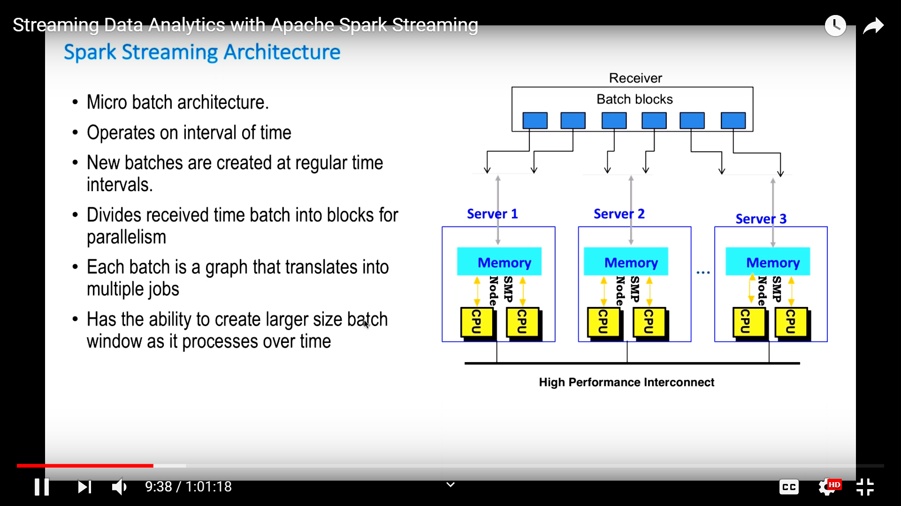
Spark Streaming Architecture
Micro batch architecture.
Operates on interval of time
New batches are created at regular time intervals.
Divides received time batch into blocks for parallelism
Each batch is a graph that translates into multiple jobs
Has the ability to create larger size batch window as it processes over time.
Big Data Computing
Spark Streaming

Slide 31
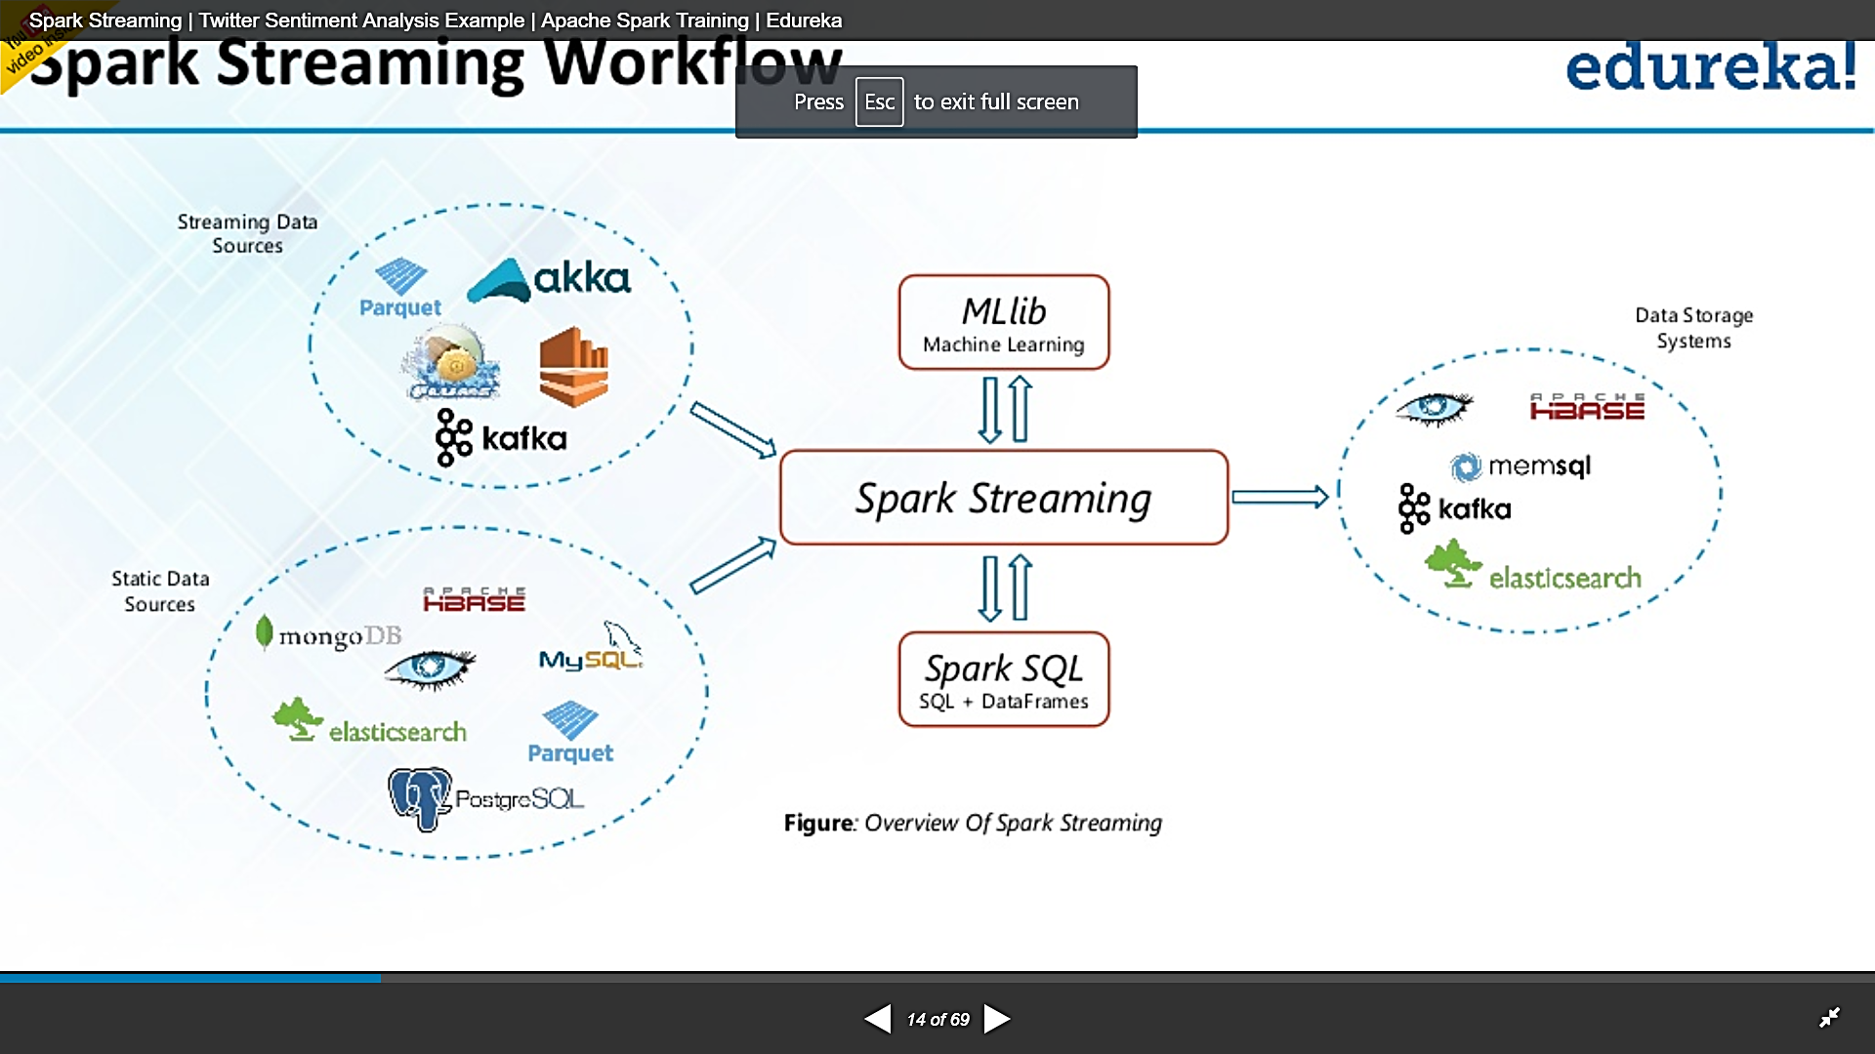
Spark Streaming Workflow
Spark Streaming workflow has four high-level stages. The first is to stream data from various sources. These sources can be streaming data sources like Akka, Kafka, Flume, AWS or Parquet for real-time streaming. The second type of sources includes HBase, MySQL, PostgreSQL, Elastic Search, Mongo DB and Cassandra for static/batch streaming.
Once this happens, Spark can be used to perform Machine Learning on the data through its MLlib API. Further, Spark SQL is used to perform further operations on this data. Finally, the streaming output can be stored into various data storage systems like HBase, Cassandra, MemSQL, Kafka, Elastic Search, HDFS and local file system.
Big Data Computing
Spark Streaming

Slide 32
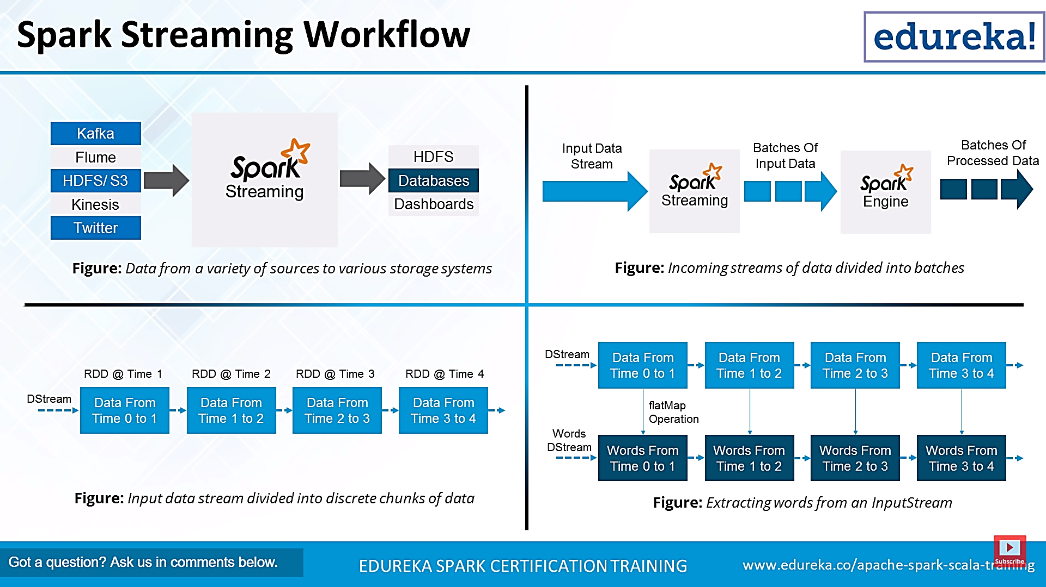
Spark Streaming Workflow
Big Data Computing
Spark Streaming

Slide 33

Example 1 – Get hashtags from Twitter
val tweets = ssc.twitterStream()
DStream: a sequence of RDDs representing a stream of data
Twitter Streaming API
batch @ t+1
batch @ t
batch @ t+2
tweets DStream
stored in memory as an RDD (immutable, distributed)
Big Data Computing
Spark Streaming

Slide 34
Example 1 – Get hashtags from Twitter
val tweets = ssc.twitterStream()
val hashTags = tweets.flatMap(status => getTags(status))
new DStream
transformation: modify data in one DStream to create another DStream
batch @ t
batch @ t+1
batch @ t+2
tweets DStream
flatMap
flatMap
flatMap
hashTags Dstream
[#cat, #dog, … ]
…
new RDDs created for every batch
Big Data Computing
Spark Streaming

Slide 35

Example 1– Get hashtags from Twitter
val tweets = ssc.twitterStream()
val hashTags = tweets.flatMap(status => getTags(status))
hashTags.saveAsHadoopFiles("hdfs://...")
output operation: to push data to external storage
batch @ t
batch @ t+1
batch @ t+2
tweets DStream
flatMap
flatMap
flatMap
hashTags DStream
save
save
save
every batch saved to HDFS
Big Data Computing
Spark Streaming

Slide 36
Example 1 – Get hashtags from Twitter
val tweets = ssc.twitterStream()
val hashTags = tweets.flatMap(status => getTags(status))
hashTags.foreach(hashTagRDD => { ... })
foreach: do whatever you want with the processed data
batch @ t
batch @ t+1
batch @ t+2
tweets DStream
flatMap
flatMap
flatMap
hashTags DStream
foreach
foreach
foreach
Write to a database, update analytics UI, do whatever you want
Big Data Computing
Spark Streaming

Slide 37
Java Example
Scala
val tweets = ssc.twitterStream()
val hashTags = tweets.flatMap(status => getTags(status))
hashTags.saveAsHadoopFiles("hdfs://...")
Java
JavaDStream<Status> tweets = ssc.twitterStream()
JavaDstream<String> hashTags = tweets.flatMap(new Function<...> { })
hashTags.saveAsHadoopFiles("hdfs://...")
Function object
Big Data Computing
Spark Streaming

Slide 38


Fault-tolerance
RDDs are remember the sequence of operations that created it from the original fault-tolerant input data
Batches of input data are replicated in memory of multiple worker nodes, therefore fault-tolerant
Data lost due to worker failure, can be recomputed from input data
tweets
RDD
input data replicated
in memory
flatMap
hashTags
RDD
lost partitions recomputed on other workers
Big Data Computing
Spark Streaming

Slide 39
Key concepts
DStream – sequence of RDDs representing a stream of data
Twitter, HDFS, Kafka, Flume, ZeroMQ, Akka Actor, TCP sockets
Transformations – modify data from on DStream to another
Standard RDD operations – map, countByValue, reduce, join, …
Stateful operations – window, countByValueAndWindow, …
Output Operations – send data to external entity
saveAsHadoopFiles – saves to HDFS
foreach – do anything with each batch of results
Big Data Computing
Spark Streaming

Slide 40
Example 2 – Count the hashtags
val tweets = ssc.twitterStream(<Twitter username>, <Twitter password>)
val hashTags = tweets.flatMap (status => getTags(status))
val tagCounts = hashTags.countByValue()
batch @ t
batch @ t+1
batch @ t+2
tweets
flatMap
flatMap
flatMap
hashTags
map
map
…
map
tagCounts
[(#cat, 10), (#dog, 25), ... ]
reduceByKey
reduceByKey
reduceByKey
Big Data Computing
Spark Streaming

Slide 41
Example 3 – Count the hashtags over last 10 mins
val tweets = ssc.twitterStream()
val hashTags = tweets.flatMap(status => getTags(status))
val tagCounts = hashTags.window(Minutes(1), Seconds(5)).countByValue()
sliding window operation
window length
sliding interval
window length
DStream of data
sliding interval
Big Data Computing
Spark Streaming

Slide 42
Example 3 – Counting the hashtags over last 10 mins
val tagCounts = hashTags.window(Minutes(10), Seconds(1)).countByValue()
t-1
t
t+1
t+2
t+3
hashTags
sliding window
countByValue
count over all the data in the window
tagCounts
Big Data Computing
Spark Streaming

Slide 43
Smart window-based countByValue
val tagCounts = hashtags.countByValueAndWindow(Minutes(10), Seconds(1))
t-1
t
t+1
t+2
t+3
hashTags
countByValue
add the counts from the new batch in the window
subtract the counts from batch before the window
–
+
tagCounts
+
?
Big Data Computing
Spark Streaming

Slide 44
Smart window-based reduce
Technique to incrementally compute count generalizes to many reduce operations
Need a function to “inverse reduce” (“subtract” for counting)
Could have implemented counting as:
hashTags.reduceByKeyAndWindow(_ + _, _ - _, Minutes(1), …)
Big Data Computing
Spark Streaming

Slide 45
Arbitrary Stateful Computations
Specify function to generate new state based on previous state and new data
Example: Maintain per-user mood as state, and update it with their tweets
def updateMood(newTweets, lastMood) => newMood
moods = tweetsByUser.updateStateByKey(updateMood _)
Big Data Computing
Spark Streaming

Slide 46
Arbitrary Combinations of Batch and Streaming Computations
Inter-mix RDD and DStream operations!
Example: Join incoming tweets with a spam HDFS file to filter out bad tweets
tweets.transform(tweetsRDD => { tweetsRDD.join(spamHDFSFile).filter(...)
})
Big Data Computing
Spark Streaming

Slide 47
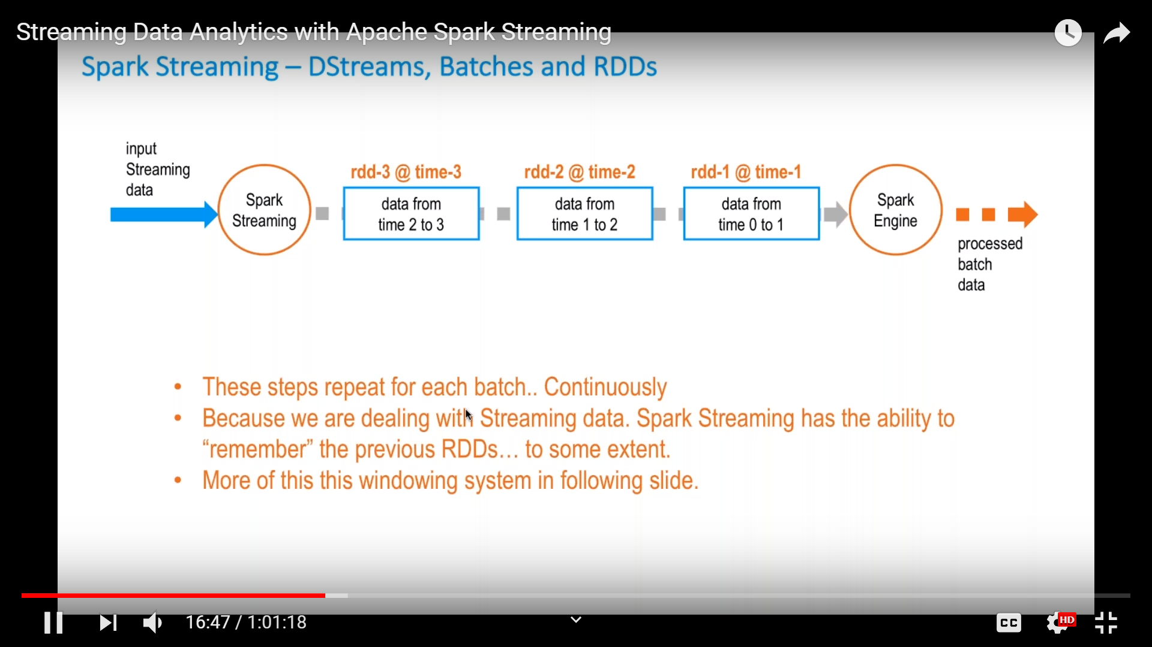
Spark Streaming-Dstreams, Batches and RDDs
These steps repeat for each batch.. Continuously
Because we are dealing with Streaming data. Spark Streaming has the ability to “remember” the previous RDDs…to some extent.
Big Data Computing
Spark Streaming

Slide 48
DStreams + RDDs = Power
Online machine learning
Continuously learn and update data models (updateStateByKey and transform)
Combine live data streams with historical data
Generate historical data models with Spark, etc.
Use data models to process live data stream (transform)
CEP-style processing
window-based operations (reduceByWindow, etc.)
Big Data Computing
Spark Streaming

Slide 49
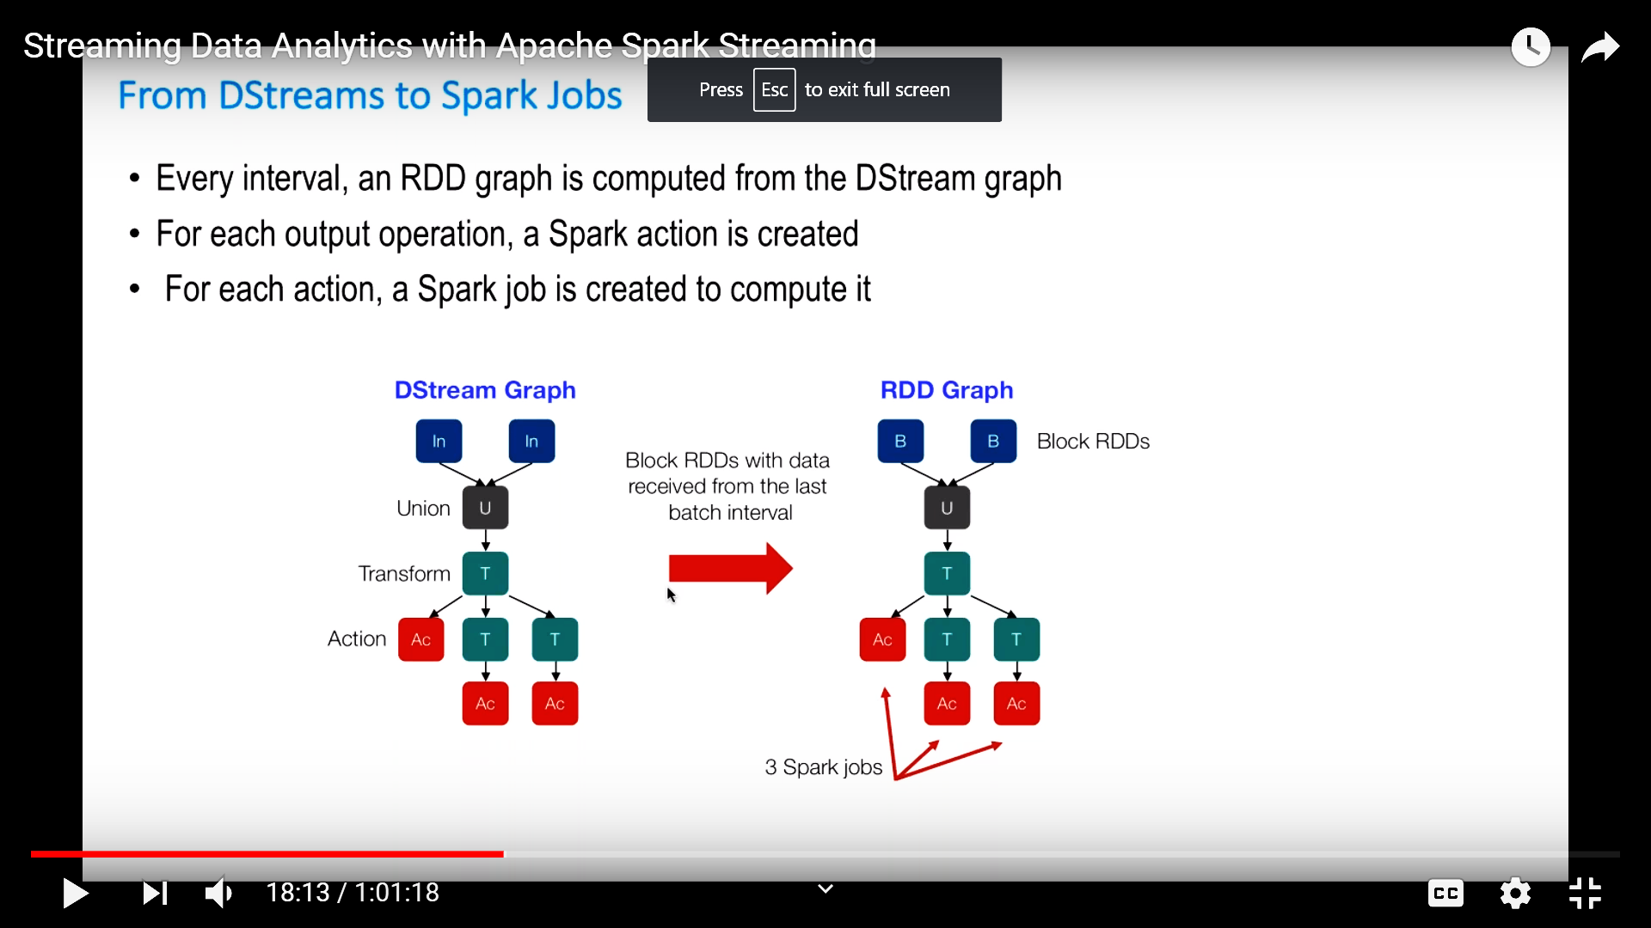
From DStreams to Spark Jobs
Every interval, an RDD graph is computed from the DStream graph
For each output operation, a Spark action is created
For each action, a Spark job is created to compute it
Big Data Computing
Spark Streaming

Slide 50
Input Sources
Out of the box, we provide
Kafka, HDFS, Flume, Akka Actors, Raw TCP sockets, etc.
Very easy to write a receiver for your own data source
Also, generate your own RDDs from Spark, etc. and push them in as a “stream”
Big Data Computing
Spark Streaming

Slide 51
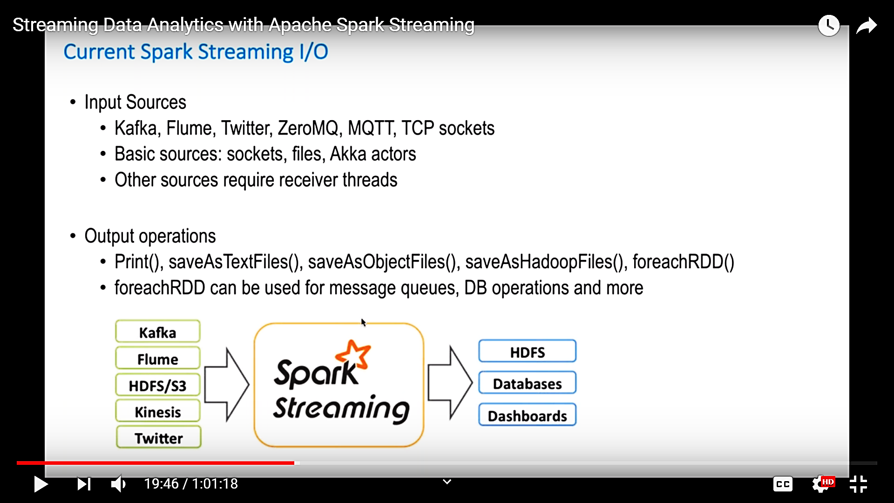
Current Spark Streaming I/O
Big Data Computing
Spark Streaming

Slide 52
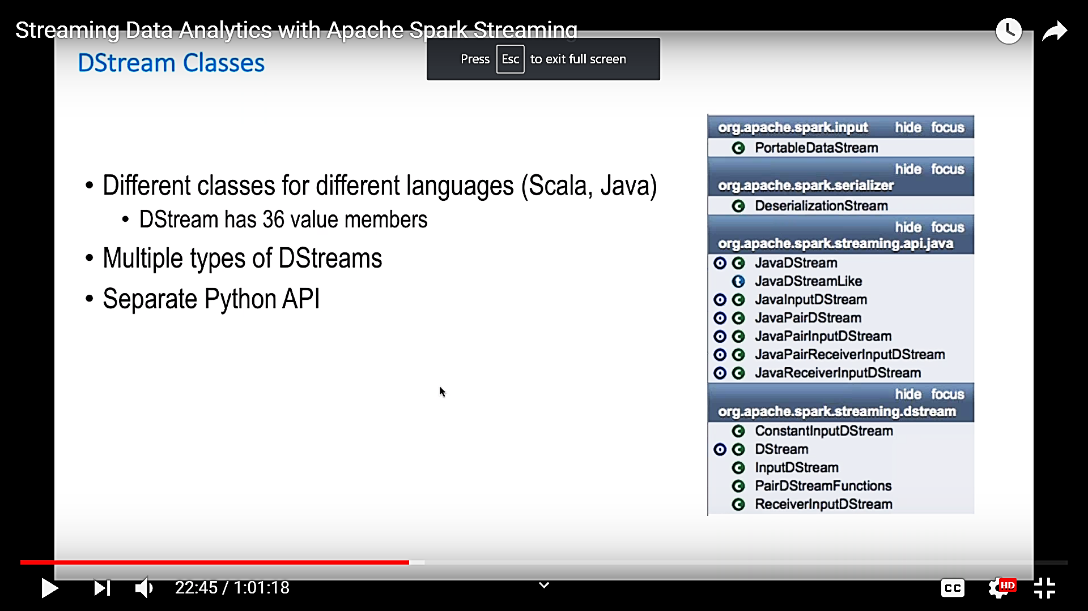
Dstream Classes
Different classes for different languages (Scala, Java)
Dstream has 36 value members
Multiple types of Dstreams
Separate Python API
Big Data Computing
Spark Streaming

Slide 53
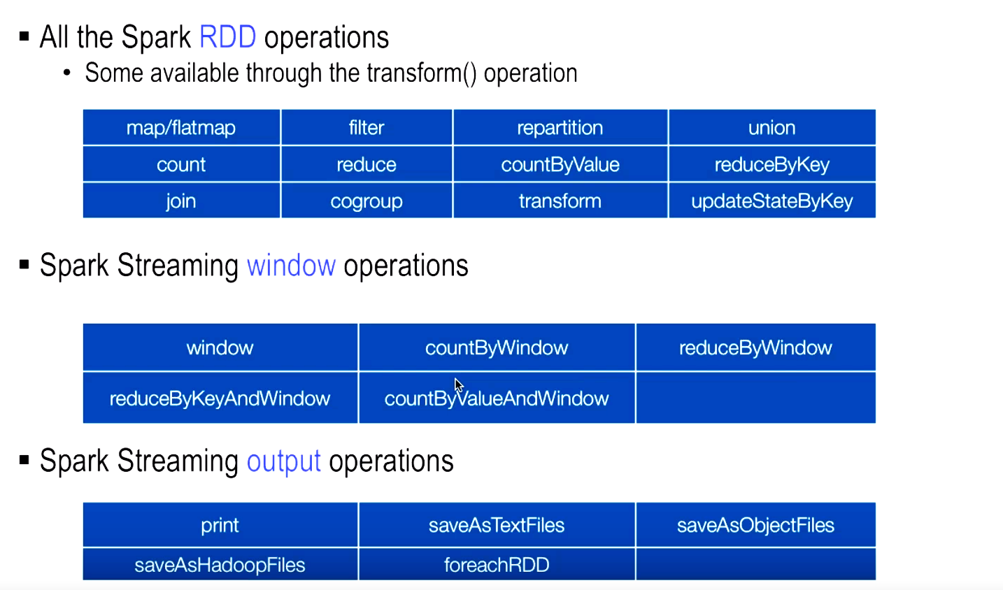
Spark Streaming Operations
Big Data Computing
Spark Streaming

Slide 54


Fault-tolerance
Batches of input data are replicated in memory for fault-tolerance
Data lost due to worker failure, can be recomputed from replicated input data
tweets
RDD
input data replicated
in memory
flatMap
All transformations are fault-tolerant, and exactly-once transformations
hashTags
RDD
lost partitions recomputed on other workers
Big Data Computing
Spark Streaming

Slide 55
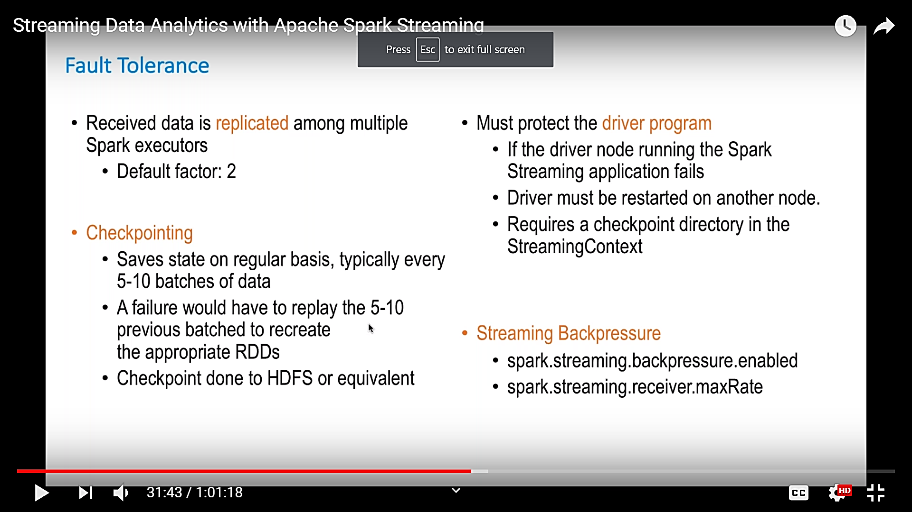
Fault-tolerance
Big Data Computing
Spark Streaming

Slide 56
Performance
Can process 60M records/sec (6 GB/sec) on
100 nodes at sub-second latency
Big Data Computing
Spark Streaming

Slide 57
Comparison with other systems
Higher throughput than Storm
Spark Streaming: 670k records/sec/node
Storm: 115k records/sec/node
Commercial systems: 100-500k records/sec/node
Big Data Computing
Spark Streaming
Notes:
Streaming Spark offers similar speed while providing FT and consistency guarantees that these systems lack

Slide 58
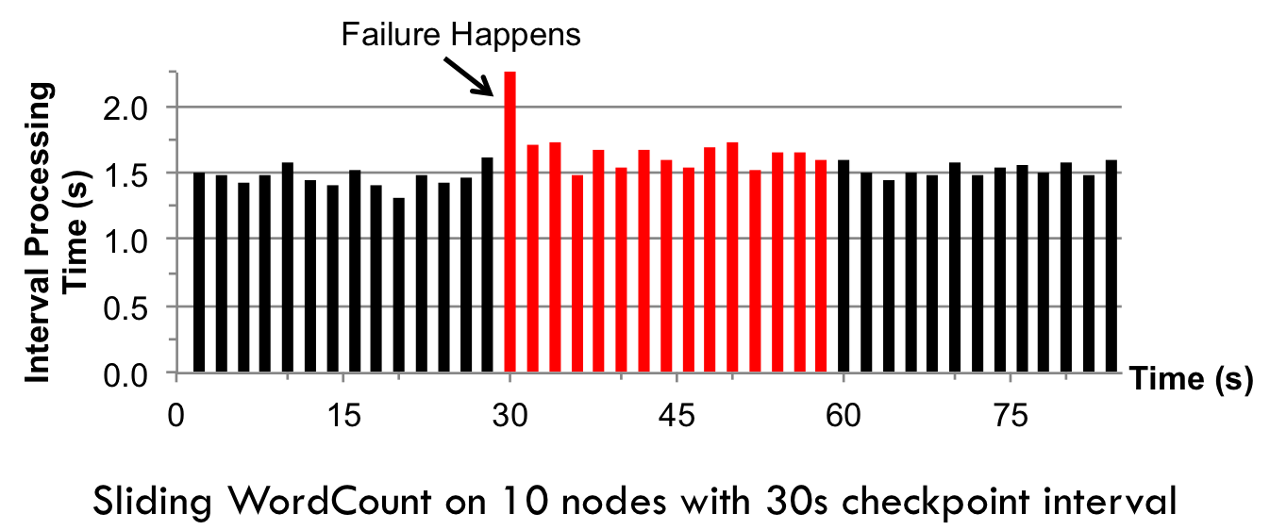
Fast Fault Recovery
Recovers from faults/stragglers within 1 sec
Big Data Computing
Spark Streaming

Slide 59
Real time application: Mobile Millennium Project
Traffic transit time estimation using online machine learning on GPS observations
Markov-chain Monte Carlo simulations on GPS observations
Very CPU intensive, requires dozens of machines for useful computation
Scales linearly with cluster size
Big Data Computing
Spark Streaming

Slide 60
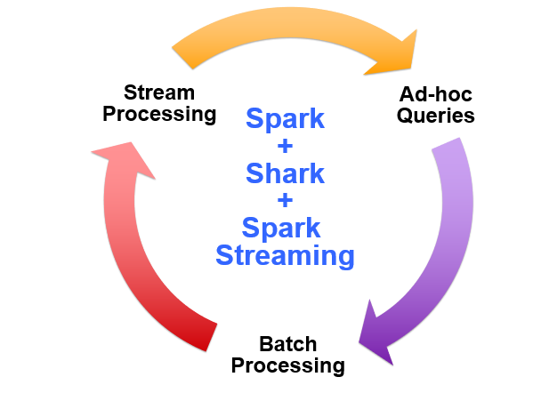
Vision - one stack to rule them all
Big Data Computing
Spark Streaming

Slide 61
Spark program vs Spark Streaming program
Spark Streaming program on Twitter stream
val tweets = ssc.twitterStream(<Twitter username>, <Twitter password>)
val hashTags = tweets.flatMap (status => getTags(status))
hashTags.saveAsHadoopFiles("hdfs://...")
Spark program on Twitter log file
val tweets = sc.hadoopFile("hdfs://...")
val hashTags = tweets.flatMap (status => getTags(status))
hashTags.saveAsHadoopFile("hdfs://...")
Big Data Computing
Spark Streaming

Slide 62
Advantage of an unified stack
Explore data interactively to identify problems
Use same code in Spark for processing large logs
Use similar code in Spark Streaming for realtime processing
$ ./spark-shell
scala> val file = sc.hadoopFile(“smallLogs”)
...
scala> val filtered = file.filter(_.contains(“ERROR”))
...
scala> val mapped = filtered.map(...)
...
object ProcessProductionData {
def main(args: Array[String]) {
val sc = new SparkContext(...)
val file = sc.hadoopFile(“productionLogs”)
val filtered = file.filter(_.contains(“ERROR”))
val mapped = filtered.map(...)
...
}
}
object ProcessLiveStream {
def main(args: Array[String]) {
val sc = new StreamingContext(...)
val stream = sc.kafkaStream(...)
val filtered = stream.filter(_.contains(“ERROR”))
val mapped = filtered.map(...)
...
}
}
Big Data Computing
Spark Streaming

Slide 63
Roadmap
Spark 0.8.1
Marked alpha, but has been quite stable
Master fault tolerance – manual recovery
Restart computation from a checkpoint file saved to HDFS
Spark 0.9 in Jan 2014 – out of alpha!
Automated master fault recovery
Performance optimizations
Web UI, and better monitoring capabilities
Spark v2.4.0 released in November 2, 2018
Big Data Computing
Spark Streaming

Slide 64
Sliding Window Analytics
Big Data Computing
Spark Streaming

Slide 65
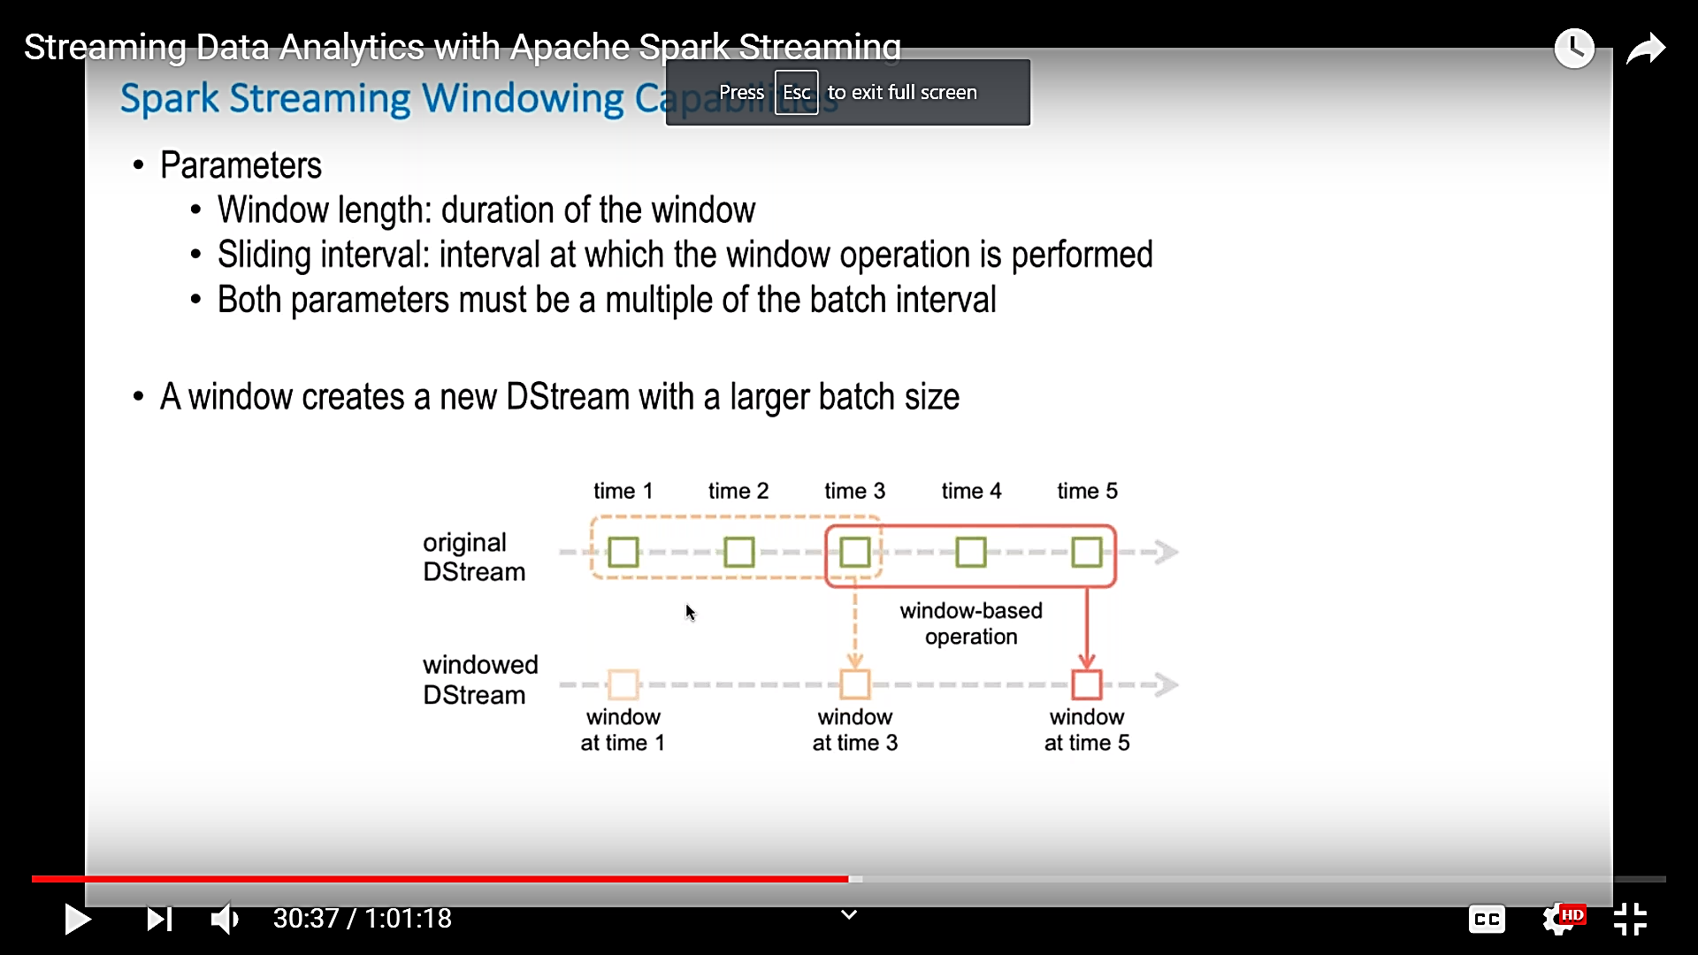
Spark Streaming Windowing Capabilities
Parameters
Window length: duration of the window
Sliding interval: interval at which the window operation is performed
Both the parameters must be a multiple of the batch interval
A window creates a new DStream with a larger batch size
Big Data Computing
Spark Streaming

Slide 66
Spark Window Functions
Spark Window Functions for DataFrames and SQL
Introduced in Spark 1.4, Spark window functions improved the expressiveness of Spark DataFrames and Spark SQL. With window functions, you can easily calculate a moving average or cumulative sum, or reference a value in a previous row of a table. Window functions allow you to do many common calculations with DataFrames, without having to resort to RDD manipulation.
Aggregates, UDFs vs. Window functions
Window functions are complementary to existing DataFrame operations: aggregates, such as sum and avg, and UDFs. To review, aggregates calculate one result, a sum or average, for each group of rows, whereas UDFs calculate one result for each row based on only data in that row. In contrast, window functions calculate one result for each row based on a window of rows. For example, in a moving average, you calculate for each row the average of the rows surrounding the current row; this can be done with window functions.
Big Data Computing
Spark Streaming

Slide 67
Moving Average Example
Let us dive right into the moving average example. In this example dataset, there are two customers who have spent different amounts of money each day.
// Building the customer DataFrame. All examples are written in Scala with Spark 1.6.1, but the same can be done in Python or SQL.
val customers = sc.parallelize(List(("Alice", "2016-05-01", 50.00),
("Alice", "2016-05-03", 45.00),
("Alice", "2016-05-04", 55.00),
("Bob", "2016-05-01", 25.00),
("Bob", "2016-05-04", 29.00),
("Bob", "2016-05-06", 27.00))).
toDF("name", "date", "amountSpent")
Big Data Computing
Spark Streaming

Slide 68
Moving Average Example
// Import the window functions.
import org.apache.spark.sql.expressions.Window
import org.apache.spark.sql.functions._
// Create a window spec.
val wSpec1 = Window.partitionBy("name").orderBy("date").rowsBetween(-1, 1)
In this window spec, the data is partitioned by customer. Each customer’s data is ordered by date. And, the window frame is defined as starting from -1 (one row before the current row) and ending at 1 (one row after the current row), for a total of 3 rows in the sliding window.
Big Data Computing
Spark Streaming

Slide 69
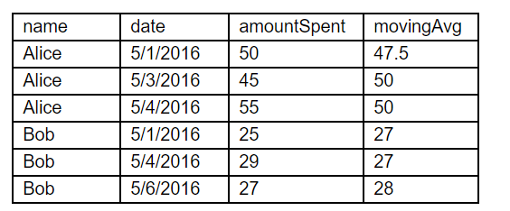
Moving Average Example
// Calculate the moving average
customers.withColumn( "movingAvg",
avg(customers("amountSpent")).over(wSpec1) ).show()
This code adds a new column, “movingAvg”, by applying the avg function on the sliding window defined in the window spec:
Big Data Computing
Spark Streaming

Slide 70
Window function and Window Spec definition
As shown in the above example, there are two parts to applying a window function: (1) specifying the window function, such as avg in the example, and (2) specifying the window spec, or wSpec1 in the example. For (1), you can find a full list of the window functions here:
https://spark.apache.org/docs/latest/api/scala/index.html#org.apache.spark.sql.functions$
You can use functions listed under “Aggregate Functions” and “Window Functions”.
For (2) specifying a window spec, there are three components: partition by, order by, and frame.
“Partition by” defines how the data is grouped; in the above example, it was by customer. You have to specify a reasonable grouping because all data within a group will be collected to the same machine. Ideally, the DataFrame has already been partitioned by the desired grouping.
“Order by” defines how rows are ordered within a group; in the above example, it was by date.
“Frame” defines the boundaries of the window with respect to the current row; in the above example, the window ranged between the previous row and the next row.
Big Data Computing
Spark Streaming

Slide 71
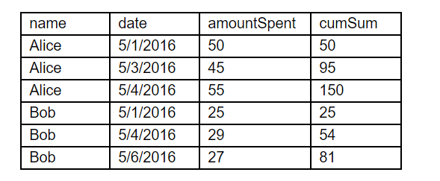
Cumulative Sum
Next, let us calculate the cumulative sum of the amount spent per customer.
// Window spec: the frame ranges from the beginning (Long.MinValue) to the current row (0).
val wSpec2 = Window.partitionBy("name").orderBy("date").rowsBetween(Long.MinValue, 0)
// Create a new column which calculates the sum over the defined window frame.
customers.withColumn( "cumSum",
sum(customers("amountSpent")).over(wSpec2) ).show()
Big Data Computing
Spark Streaming

Slide 72
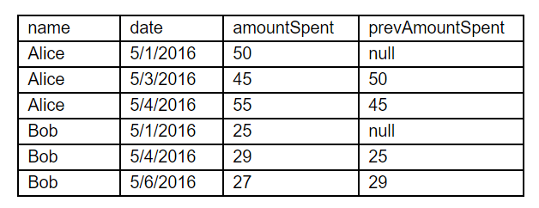
Data from previous row
In the next example, we want to see the amount spent by the customer in their previous visit.
// Window spec. No need to specify a frame in this case.
val wSpec3 = Window.partitionBy("name").orderBy("date")
// Use the lag function to look backwards by one row.
customers.withColumn("prevAmountSpent",
lag(customers("amountSpent"), 1).over(wSpec3) ).show()
Big Data Computing
Spark Streaming

Slide 73
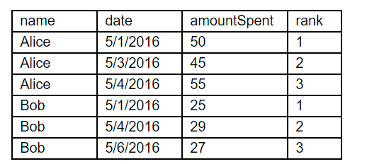
Rank
In this example, we want to know the order of a customer’s visit (whether this is their first, second, or third visit).
// The rank function returns what we want.
customers.withColumn( "rank", rank().over(wSpec3) ).show()
Big Data Computing
Spark Streaming

Slide 74
Case Study: Twitter Sentiment Analysis with Spark Streaming
Big Data Computing
Spark Streaming

Slide 75
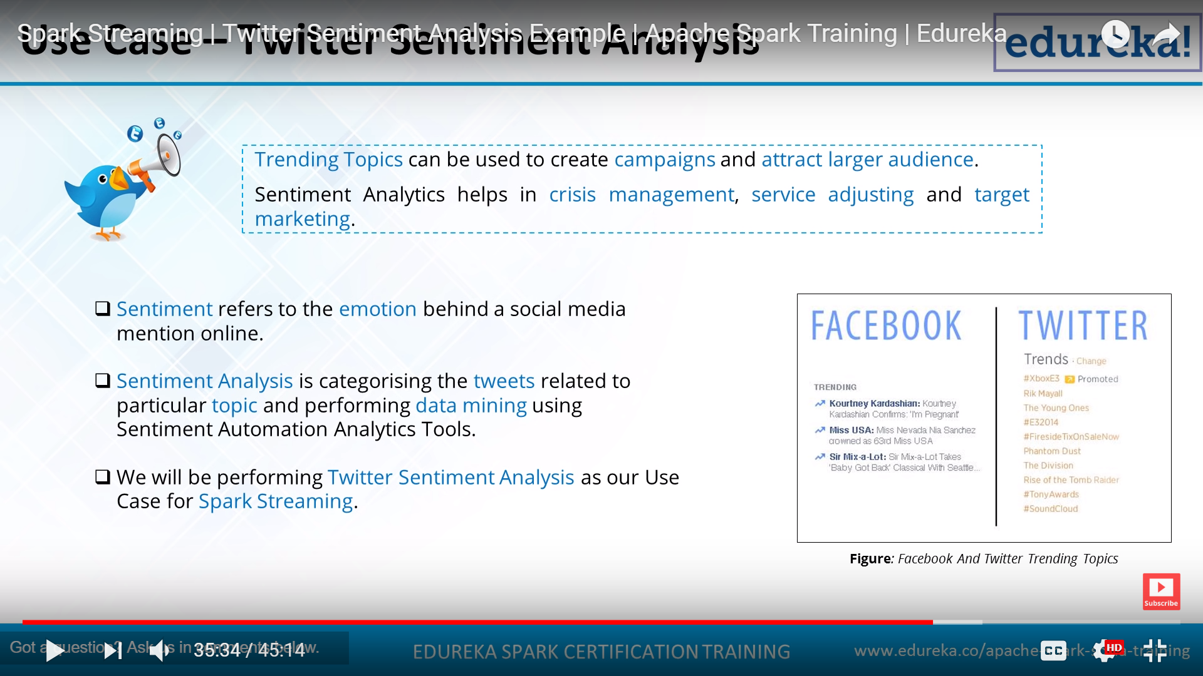
Case Study: Twitter Sentiment Analysis
Trending Topics can be used to create campaigns and attract larger audience. Sentiment Analytics helps in crisis management, service adjusting and target marketing.
Sentiment refers to the emotion behind a social media mention online.
Sentiment Analysis is categorising the tweets related to particular topic and performing data mining using Sentiment Automation Analytics Tools.
We will be performing Twitter Sentiment Analysis as an Use Case or Spark Streaming.
Big Data Computing
Spark Streaming

Slide 76
Problem Statement
To design a Twitter Sentiment Analysis System where we populate real-time sentiments for crisis management, service adjusting and target marketing.
Sentiment Analysis is used to:
Predict the success of a movie
Predict political campaign success
Decide whether to invest in a certain company
Targeted advertising
Review products and services
Big Data Computing
Spark Streaming

Slide 77
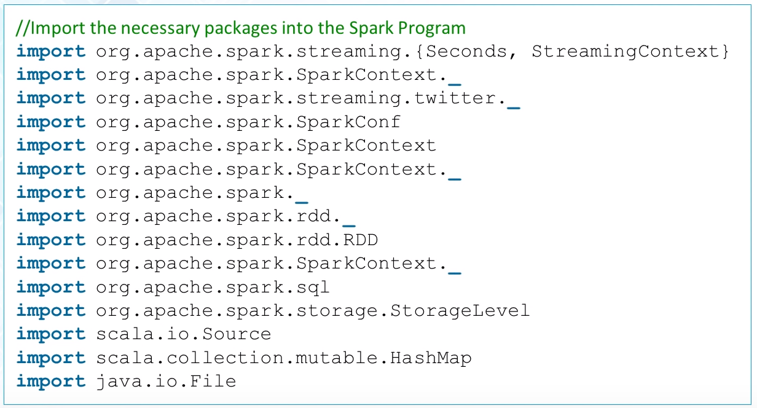
Importing Packages
Big Data Computing
Spark Streaming

Slide 78
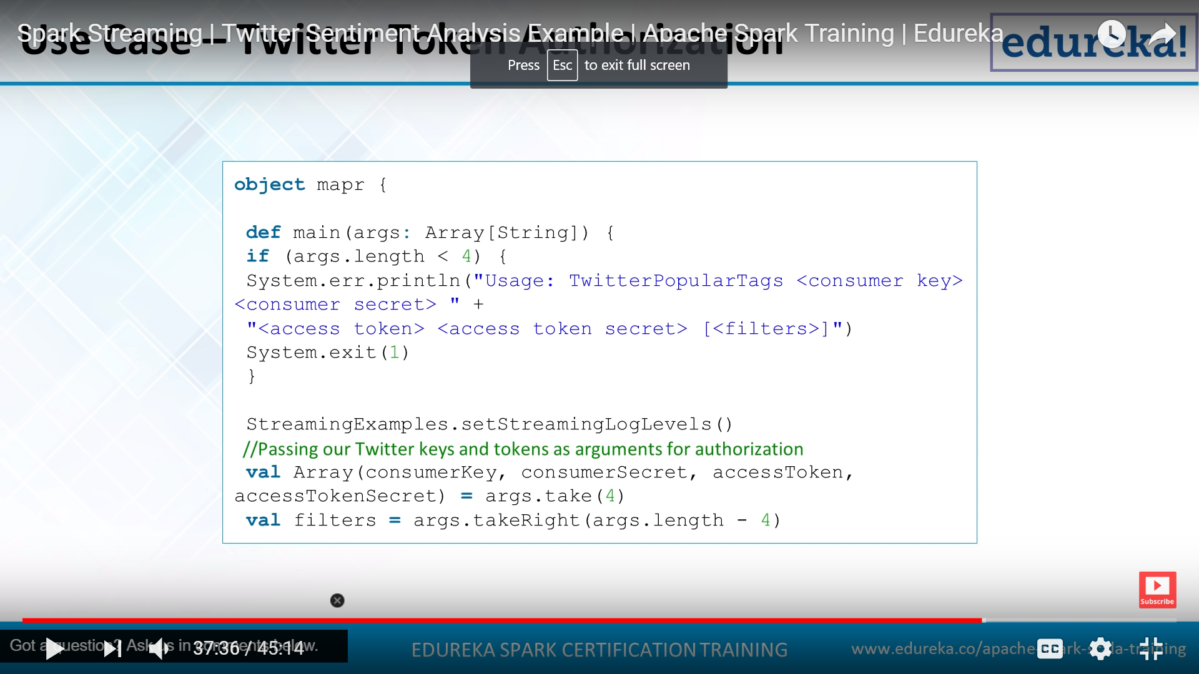
Twitter Token Authorization
Big Data Computing
Spark Streaming

Slide 79
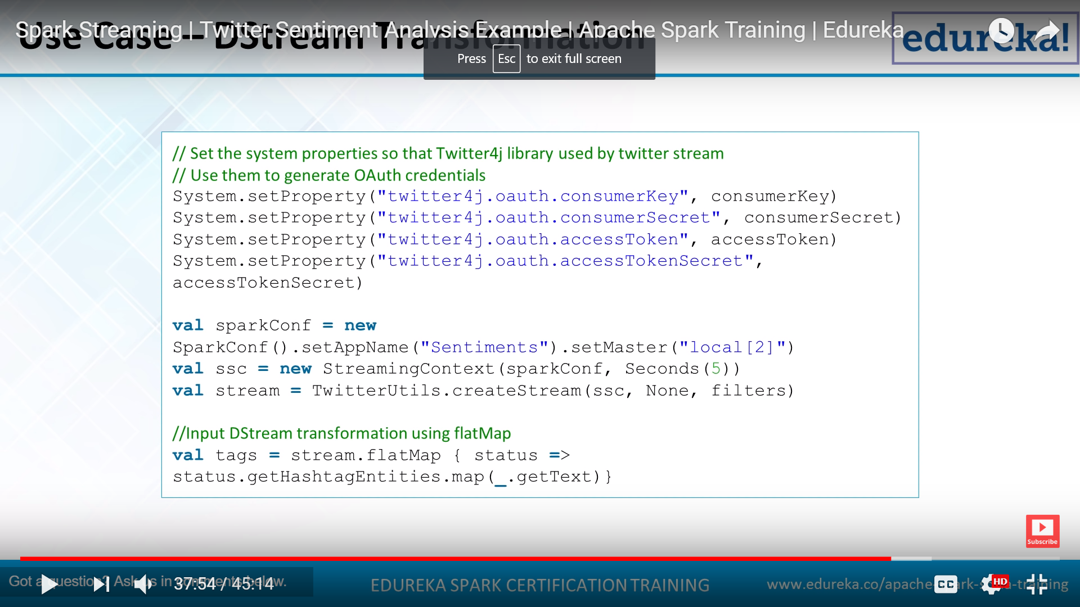
DStream Transformation
Big Data Computing
Spark Streaming

Slide 80
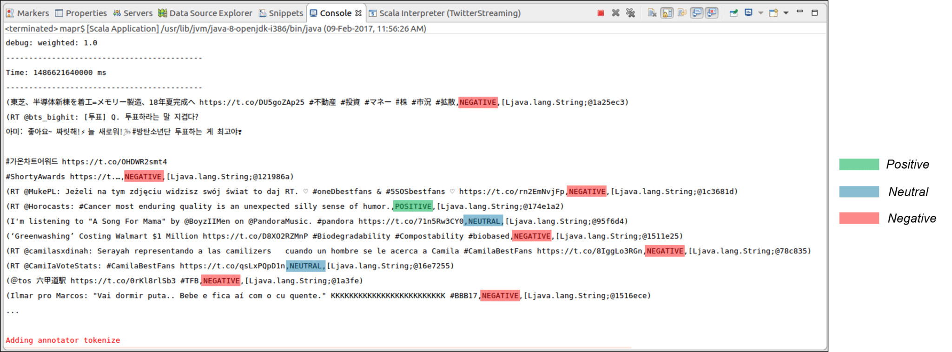
Results
Big Data Computing
Spark Streaming

Slide 81
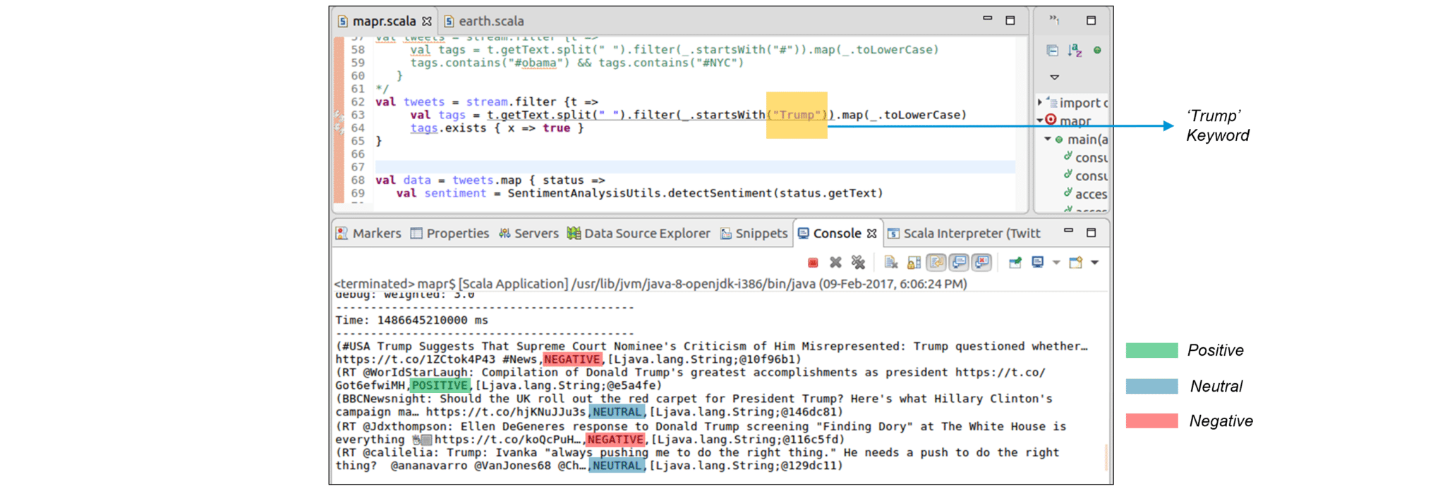
Sentiment for Trump
Big Data Computing
Spark Streaming

Slide 82
Applying Sentiment Analysis
As we have seen from our Sentiment Analysis demonstration, we can extract sentiments of particular topics just like we did for ‘Trump’. Similarly, Sentiment Analytics can be used in crisis management, service adjusting and target marketing by companies around the world.
Companies using Spark Streaming for Sentiment Analysis have applied the same approach to achieve the following:
Enhancing the customer experience
Gaining competitive advantage
Gaining Business Intelligence
Revitalizing a losing brand
Big Data Computing
Spark Streaming

Slide 83
References
https://spark.apache.org/streaming/
Streaming programming guide –
spark.incubator.apache.org/docs/latest/streaming-programming-guide.html
https://databricks.com/speaker/tathagata-das
Big Data Computing
Spark Streaming

Slide 84
Conclusion
Stream processing framework that is ...
Scalable to large clusters
Achieves second-scale latencies
Has simple programming model
Integrates with batch & interactive workloads
Ensures efficient fault-tolerance in stateful computations
Big Data Computing
Spark Streaming

